Slide 1
Respiration Fun!

Slide 2
Using this analogy, which would be a $100 bill… a lipid or a carbohydrate?
Cellular respiration is like a change machine: you’re turning sugars into ATP so it will be a usable form of energy. If you go to a coin operated laundromat, they all seem to run on quarters for some reason. So you might say, “I don’t have any quarters but I want to wash my clothes and I have a $10 bill.” You put your $10 bill into the change machine and you get 40 quarters and now you could use the coin operated washers and dryers. All the chemical reactions in living things run off of these quarters (ATP). They don’t run off $10 bills (sugars/fats/proteins).

Slide 3
Life Is Work – (get used to it!)
Living cells require energy from outside sources
Watch:
Bioflix animation on Respiration
© 2011 Pearson Education, Inc.
Notes:
For the Discovery Video Space Plants, go to Animation and Video Files.

Slide 4
Respiration
Glycolysis
Breaks down glucose into two molecules of pyruvate
The citric acid cycle/Krebs
Completes the breakdown of glucose
Oxidative phosphorylation/Electron Transport Chain
Is driven by the electron transport chain
Generates ATP
→ The main idea of cellular respiration is that energy found in the
electrons from the food we eat can be transferred through a series of “step
down” redox reactions to eventually be used to join ADP +Pi yielding
ATP.

Slide 5
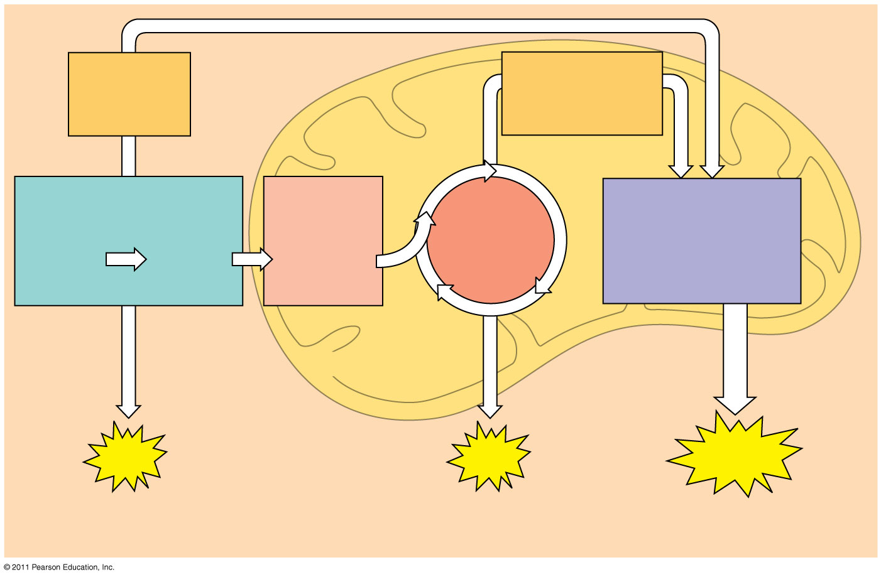
Figure 9.6-3
Electrons carried via NADH
Electrons carried via NADH and FADH₂
Pyruvate oxidation
Oxidative phosphorylation: electron transport and chemiosmosis
Glycolysis
Citric acid cycle
Glucose
Pyruvate
Acetyl CoA
CYTOSOL
MITOCHONDRION
ATP
ATP
ATP
Substrate-level phosphorylation
Substrate-level phosphorylation
Oxidative phosphorylation
2 ATP 2 ATP 34 ATP
Notes:
Figure 9.6 An overview of cellular respiration.

Slide 6
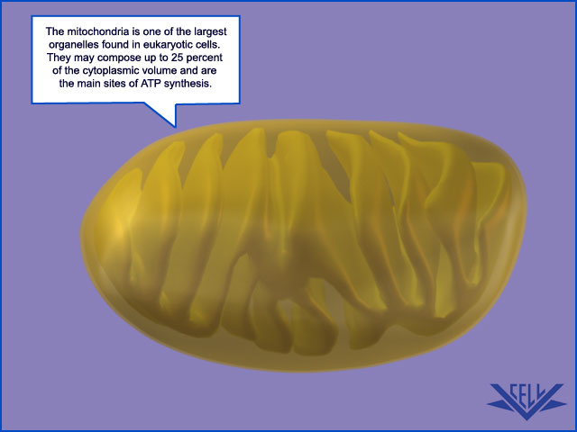

Slide 7
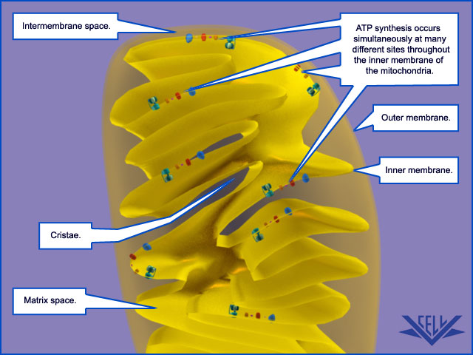

Slide 8
Krebs Cycle!
→ the purpose of respiration is to produce ATP, but glycolysis and Krebs cycle only make 4 ATP by the time glucose is converted to CO₂… when do we get the rest of the ATP made??

Slide 9
Krebs Cycle!
It is shuttled by electron carriers (NADH and FADH₂) to the final phase which will generate 90% of the ATP

Slide 10
End product of Glycolysis: _Pyruvate__
Starting product of Krebs Cycle: _____Acetyl CoA_____

Slide 11
Where did Acetyl CoA come from?
When pyruvate enters the mitochondrial matrix it is converted to Acetyl CoA
CO2 is released during this process

Slide 12
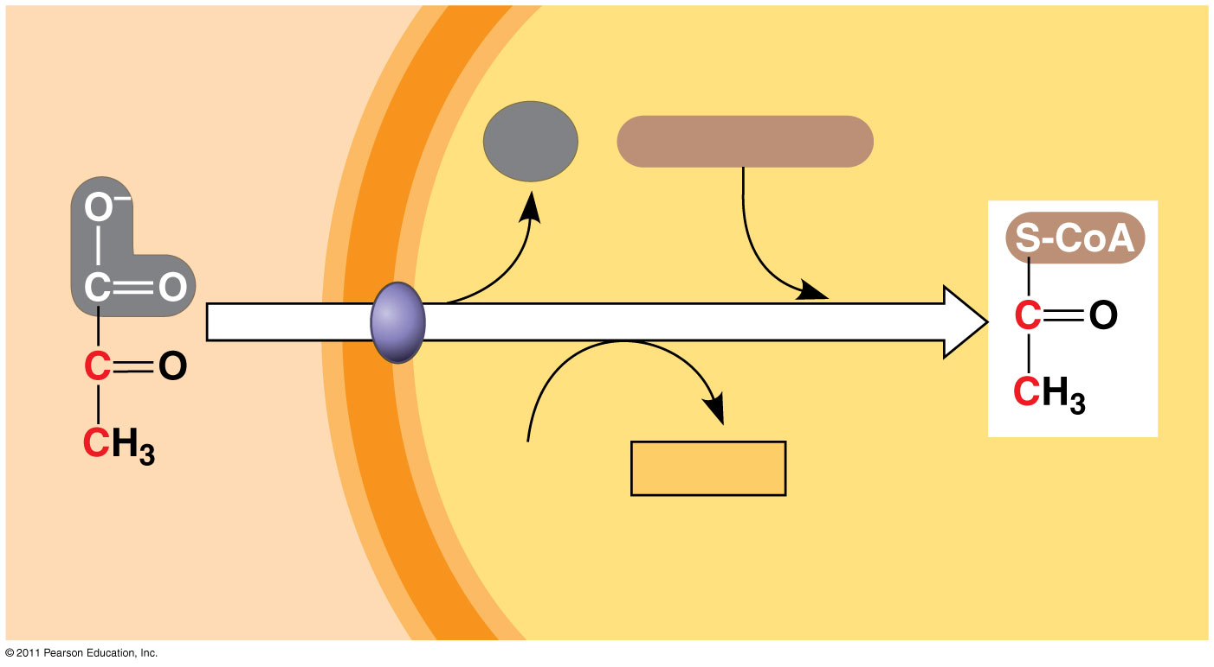
Figure 9.10
MITOCHONDRION
CYTOSOL
CO₂
Coenzyme A
1
3
2
NAD⁺
NADH
+ H⁺
Acetyl CoA
Pyruvate
Transport protein
Notes:
Figure 9.10 Oxidation of pyruvate to acetyl CoA, the step before the citric acid cycle.

Slide 13
Krebs's Cycle (citric acid cycle)
Goal: take pyruvate and put it into the Krebs's cycle, producing NADH and FADH₂
Location: the mitochondria (matrix)
Produces (per molecule of glucose):
2 ATP, 4 CO₂ , 6 NADH, and 2FADH₂
→ In the Krebs's cycle, all of Carbons, Hydrogens, and Oxygens from pyruvate end up as CO₂ and H₂O

Slide 14
The citric acid cycle has eight steps, each catalyzed by a specific enzyme
Acetyl CoA joins the cycle by combining with oxaloacetate, forming citrate
The next seven steps decompose the citrate back to oxaloacetate, making the process a cycle
© 2011 Pearson Education, Inc.

Slide 15
The NADH and FADH₂ produced by the cycle relay electrons extracted from food to the electron transport chain

Slide 16
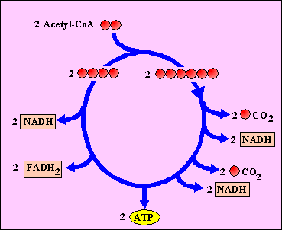
The Kreb's Cycle
6 NADH's are generated
2 FADH₂ is generated
2 ATP are generated
4 CO₂'s are released

Slide 17
Electron Transport Chain and Oxidative Phosphorylation
The electron transport chain allows the release of the large amount of chemical energy stored in reduced NAD⁺ (NADH) and reduced FAD (FADH₂). The energy released is captured in the form of ATP (3 ATP per NADH and 2 ATP per FADH₂).

Slide 18
Where do the electrons for the electron transport chain come from?

Slide 19
Where do the electrons for the electron transport chain come from?
NADH and FADH2
(which originally got them from glucose in the previous phases)

Slide 20
What molecule is the final acceptor of the electron?

Slide 21
What molecule is the final acceptor of the electron?
oxygen
Water is Made from oxygen gas molecule and grabbing 2 hydrogen ions from the inner membrane space

Slide 22
What is consumed during this process?

Slide 23
What is consumed during this process?
Oxygen gas

Slide 24
What is gained by this process?

Slide 25
What is gained by this process?
a chemiosmotic gradient H+ ions inside the inner membrane space

Slide 26
After glycolysis and citric acid cycle…
NADH and FADH₂ account for most of the energy extracted from food
These two electron carriers donate electrons to the electron transport chain, which powers ATP synthesis via oxidative phosphorylation

Slide 27
→ Electron Transport Chain: doesn’t generate ATP directly, but generates a chemiosmotic gradient that will eventually generate ATP

Slide 28
So what does it do?
The carriers accept and donate electrons
Electrons drop in free energy as they go down the chain and are finally passed to O₂, forming H₂O

Slide 29
Creates an H+ gradient that will fuel ATP synthesis by ATP Synthase

Slide 30
Chemiosmosis: The Energy Coupling Mechanism
Couples electron transport to ATP synthesis
During oxidative phosphorylation
© 2011 Pearson Education, Inc.
Notes:
For the Cell Biology Video ATP Synthase 3D Structure — Side View, go to Animation and Video Files.
For the Cell Biology Video ATP Synthase 3D Structure — Top View, go to Animation and Video Files.

Slide 31
Chemiosmosis:
H+ is pumped into the intermembrane space
H⁺ then moves back across the membrane, passing through the protein, ATP synthase
© 2011 Pearson Education, Inc.

Slide 32
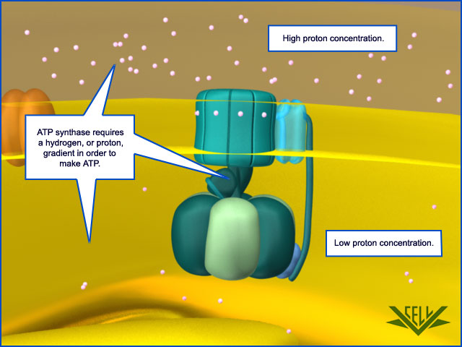
ATP Synthase
uses the exergonic flow of H⁺ to drive phosphorylation of ATP

Slide 34
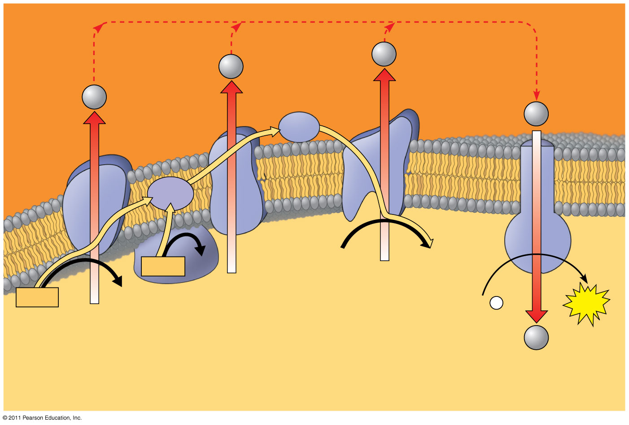
Figure 9.15
H⁺
H⁺
Protein complex of electron carriers
H⁺
H⁺
Cyt c
IV
Q
III
I
ATP synth- ase
II
FADH₂
FAD
2 H⁺ + ¹/₂O₂
H₂O
NADH
NAD⁺
ADP + P _{i}
ATP
(carrying electrons from food)
H⁺
1
Electron transport chain
2
Chemiosmosis
Oxidative phosphorylation
Notes:
Figure 9.15 Chemiosmosis couples the electron transport chain to ATP synthesis.

Slide 35
What is Oxidative Phosphorylation?

Slide 36
How does this gradient generate ATP?
A protein embedded in the inner membrane uses the flow of H+ ions to phosphorylate ADP
ADP + P → ATP! (adenosine Diphosphate + P → adenosine TRIphosphate. Woah.)

Slide 37
How does this specialized membrane protein work?
It turns like a wheel, as the H+ rush through the channel, cause chemical energy to be converted to mechanical energy, which in turn is used to drive a phosphorylation reaction

Slide 38
This process is called oxidative phosphorylation

