Slide 1
PLANT NUTRITION
AP Biology
Mrs. Oldendorf

Slide 2
Nutrition is
The process by which organisms obtain, synthesize, and utilize the molecules (nutrients) necessary for the organism to carry out life functions
  (reproduction/development, respiration, growth, repair, response, etc…)

Slide 3
Nutrition provides…
ENERGY and Molecular building blocks from the environment
Contain Carbon, Hydrogen, Oxygen, Nitrogen

Slide 4
Nutrition is organized into 6 major classes
Carbs
Lipids
Proteins
Nucleic acids
Vitamins
Minerals
Water
Too little = disease
Too much = toxicity

Slide 5
Autotrophs
Use inorganic molecules to make “nutritive”organic molecules via photosynthesis (using light energy) or chemosynthesis (using chemical energy)
Producers in a food web

Slide 6
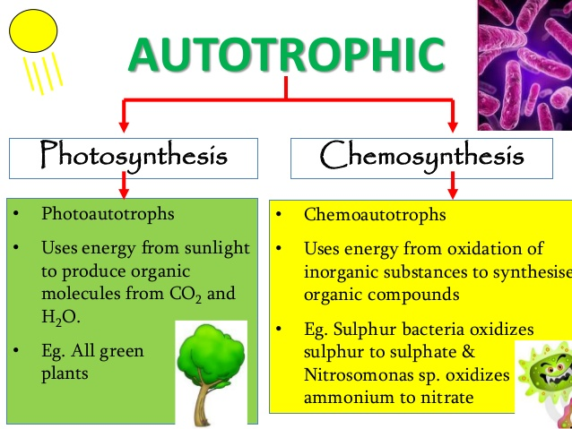

Slide 7
Plant Nutrients
(Inorganic Molecules)

Slide 8
Macronutrients – 1g/kg of plant matter required
*Most fertilizers contain a mix of Nitrogen, Phosphorous, and Potassium
(these are the most important for plant growth – N,P,K)

Slide 9
Micronutrients - <.1g/kg plant matter

Slide 10
What is SOIL?
Highly weathered outer layer of the Earth’s crust
Consists of a mixture of sand, rock, clay, silt, minerals, and microorganisms
Organic matter = roots, small organisms
Contains sufficient nutrients to support plant growth
    Organic matter, minerals, water, air, organisms
Quality and composition affect plant growth distribution

Slide 11
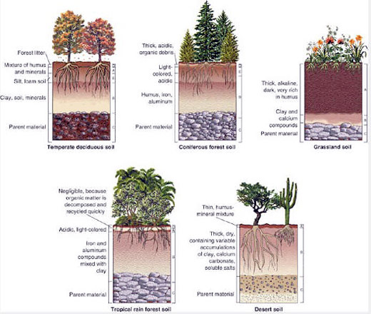

Slide 12
Benefits gained from Soil
Anchorage
Mineral nutrients, water, oxygen
Relationships with other organisms
  Bacteria, fungi, animals (earthworms, arthropods, etc.)
    Organisms aerate the soil, create pores so water can enter, and increase the available nutrients

Slide 13
Nutrient Availability
soil nutrients must be DISSOLVED in WATER for uptake by plants
½ of topsoil volume is pores
  Containing water and/or air

Slide 14
Loss of Topsoil
Drastic/dramatic issue
>50 Billion tons lost/year
1930s Dust Bowl

Slide 15
pH and Cation/Anion Exchange
  Proton Pumps in membranes of root hairs
  CO2 released from respiration, H+ pumped out into soil
  Exhange of ions (H+) and other cations between soil and clay allow cations to be taken up by plants

Slide 16
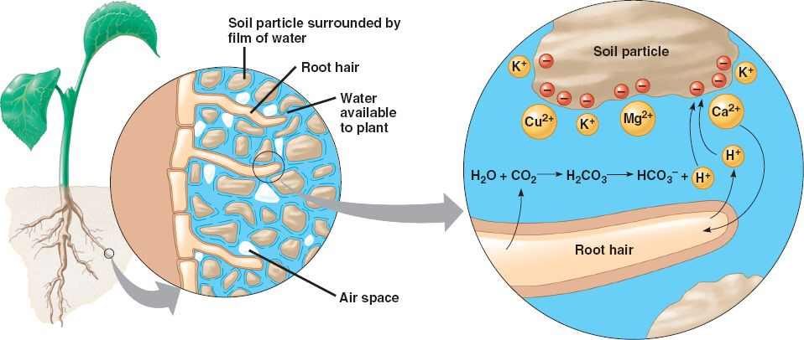
Minerals and ions enter the plant by either passive or active transport, depending on the mineral/ion.

Slide 17
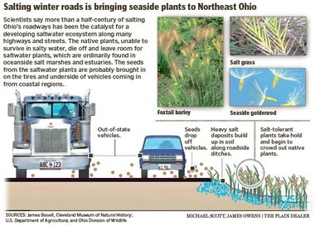
Salinity and Soil
Increases in [Na+] and [Cl-] change the water potential
  Causes water to move out of plant rather than into plant → dehydration
      Example: Road Icing and Salting the Roads in Winter – kills the plants by making the soil hypertonic

Slide 18
Soil Organisms
Make nutrients and water available to plants
Leads to relationships between plants and soil organisms

Slide 19
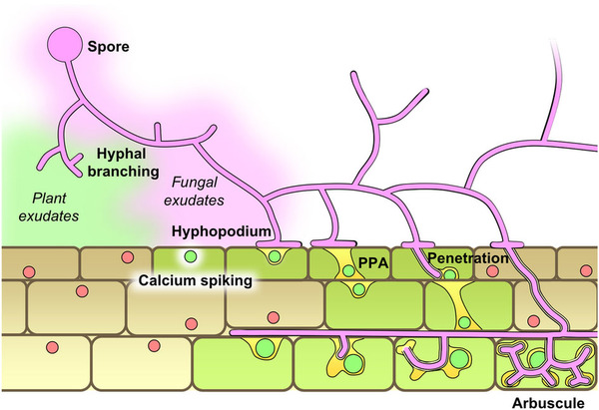
Mycorrizhae growth with plants

Slide 20
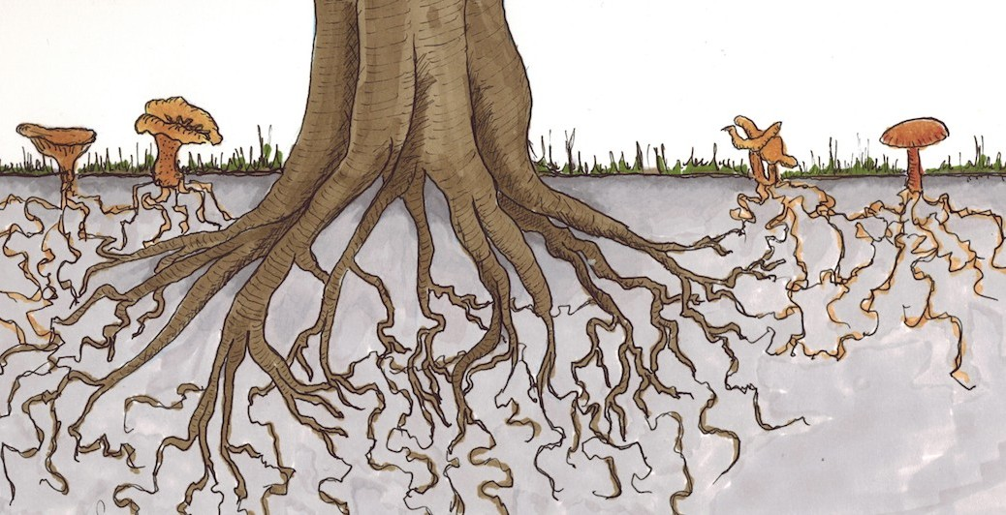
Mycorrhizae
Symbiotic relationship between the roots of plants and the hyphae of fungus

Slide 21
Mycorrhizae
  1. increases surface area for nutrient absorption
    Up to 700% increase!!
  2. plants signal the fungus to grow towards plant
  3. fungus provides phosphorous, plants provide sugar
    ~20% of photosynthetic products!

Slide 22
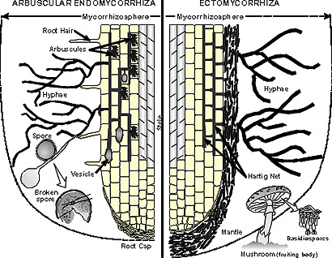
Penetrate between and into cells

Slide 23
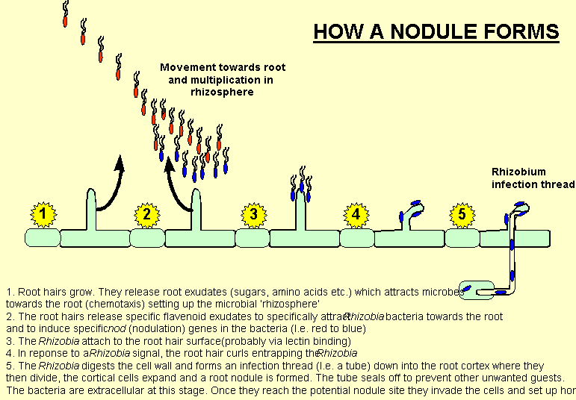

Slide 24
Rhizobia, Root Nodules, & Nitrogen
The Nitrogen (N2) in the atmosphere is UNAVAILABLE to plants!!
It must be “fixed” into usable compounds (nitrogen fixation)
  Ammonia, nitrites → nitrates
    Through the process of Ammonification and Nitrification
  PLANTS LOVE NITRATES!!
  The other stuff (ammonia, nitrites), not so much, so the bacteria must convert it

Slide 25
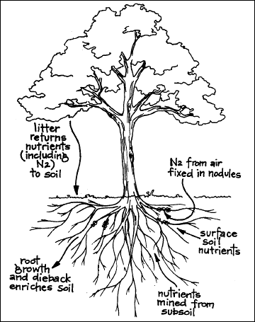

Slide 26
Plants signal Rhizobia (n-fixing bacteria) with flavonoids
  Causes them to migrate towards plant
Bacteria provides “fixed” nitrogen, plants provide sugar

Slide 27
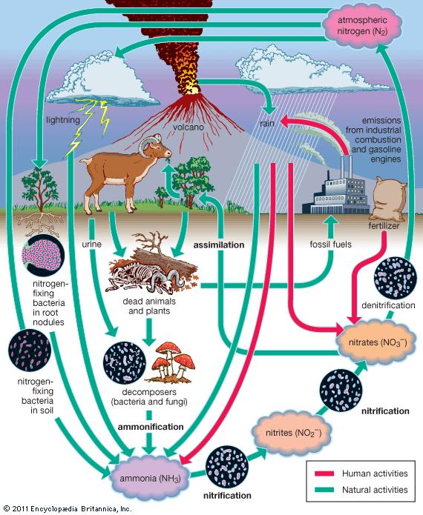

Slide 28
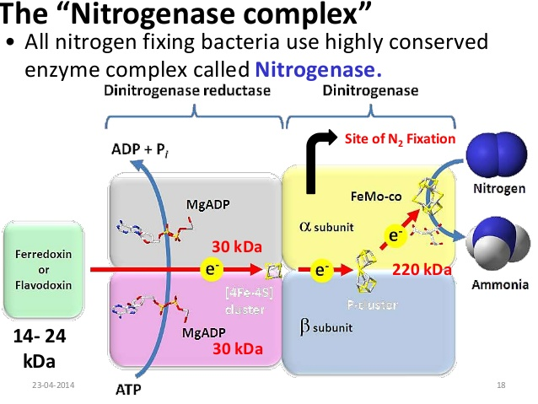
Nitrogenase and N2

Slide 29
Nutritional Adaptations
Carnivory
  Venus fly trap
  Pitcher Plant
Digest arthropods to get nutrients
Usually grow in Nitrogen-deficient soils

Slide 30
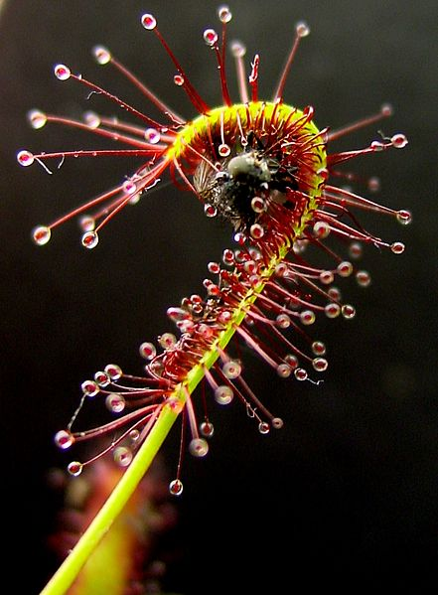
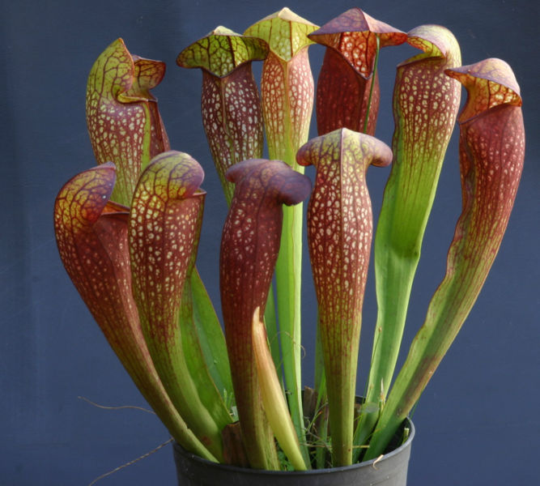
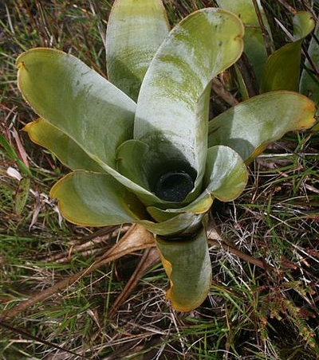
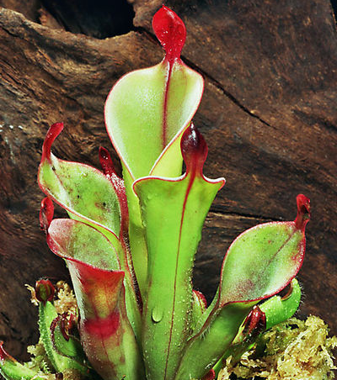

Slide 31
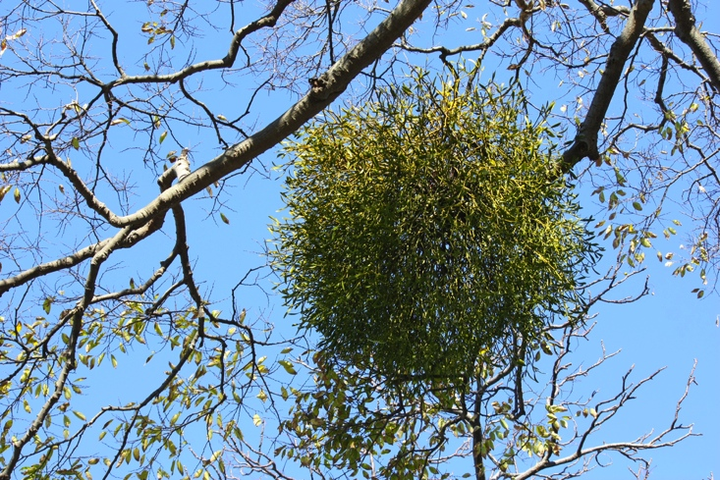
Parasitic Plants
“steal” water, minerals, photosynthetic products from host plant
Example: mistletoe

Slide 32
6 classifications of parasitic plants
Obligate parasite –
  cannot complete its life cycle without a host.
Facultative parasite –
  can complete its life cycle independent of a host.
Stem parasite –
  attaches to the host stem.
Root parasite –
  attaches to the host root.
Holoparasite –
  is completely parasitic on other plants and has virtually no chlorophyll.
Hemiparasite –
  is parasitic under natural conditions and is also photosynthetic to some degree.
  may just obtain water and mineral nutrients from the host plant
  Many obtain at least part of their organic nutrients from the host as well.

Slide 33
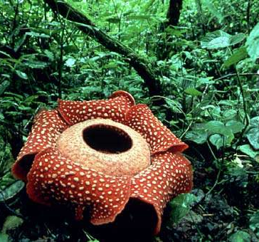
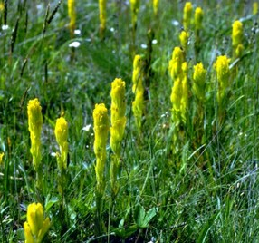
Holoparasites
(Rafflesia)
Hemiparasites
(golden paintbrush)

