Slide 1
How it happens (evolution, my friend!)
A brief overview…

Slide 3
Fitness = a measure of an organism’s reproductive success
Consequences of Natural Selection:
An increasing proportion of individuals in SUCCEEDING GENERATIONS will have the adaptive traits
The result is a POPULATION ADAPTED TO ITS LOCAL ENVIRONMENT

Slide 4
NATURAL SELECTION ACTS UPON INDIVIDUALS, BUT CHANGES POPULATIONS

Slide 5
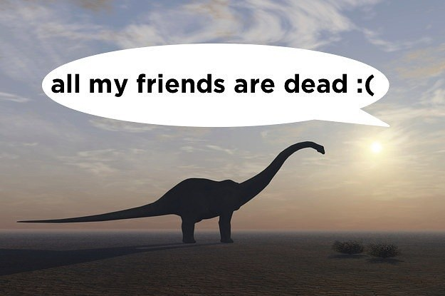
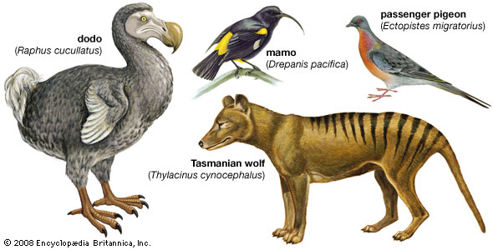
Extinction
Occurs when previous adaptations are no longer suitable for the present environment

Slide 7
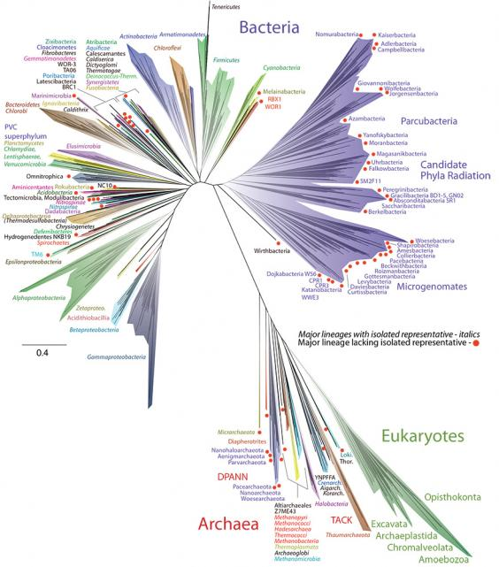
If we accept that life evolves, logic suggests that all life shares a common ancestor.
This is supported by all of the evidence we have found.

Slide 8
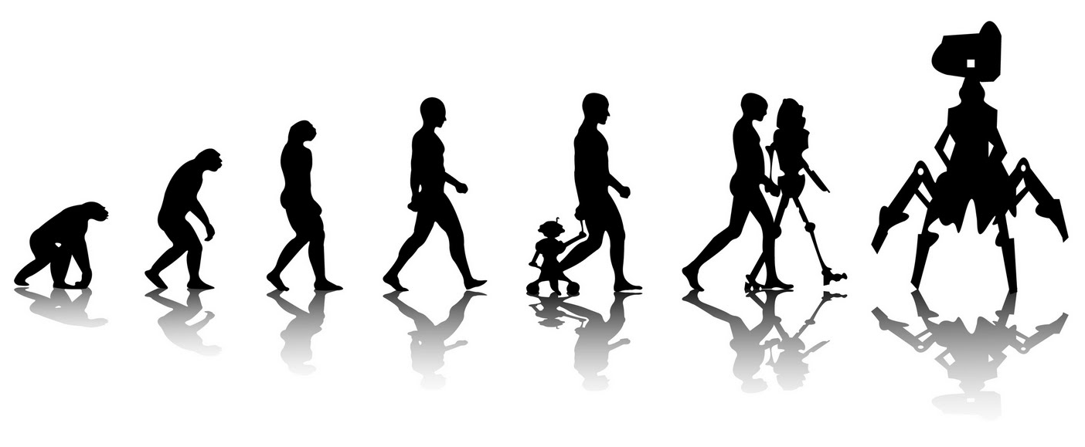
Microevolution
evolution that occurs within a population
Key vocab:
Population - all the members of a single species occupying a certain area at the same time.
Population genetics studies the variation in alleles in a gene pool.
The gene pool is the total of all the alleles in a population; it is described in terms of gene frequencies.

Slide 9
CAUSES OF MICROEVOLUTION
The Five Main Causes (video)

Slide 10
Causes of microevolution:
1. Natural Selection
2. Genetic Drift (CHANCE! Founder effect, bottleneck effect)

Slide 11
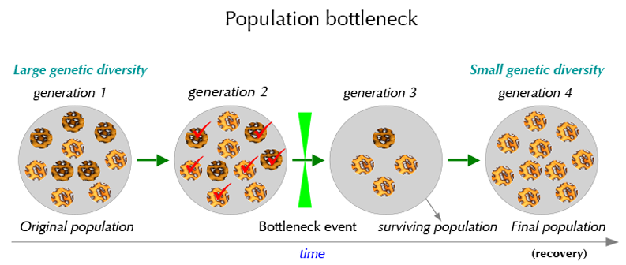
Bottleneck Effect
severe reduction in population size due to a natural disaster, predation, or habitat reduction.
→ Leads to a severe reduction in the total genetic diversity of the original gene pool.

Slide 12
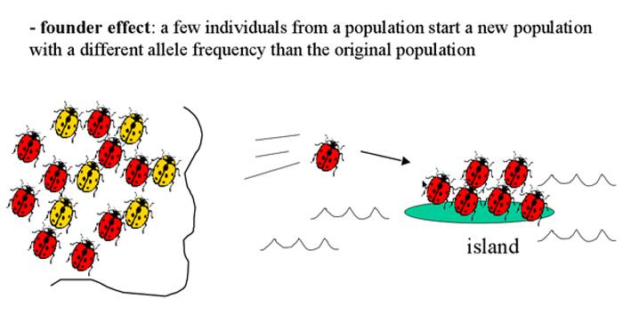
Founder Effect
rare alleles or combinations occur in higher frequency in an isolated population
alleles carried by the founders is dictated by chance
-- example: dwarfism and polydactyl is much higher in a Pennsylvania Amish community due to a few German founders.

Slide 13
3. Nonrandom Mating
= individuals choosing a mate
Inbreeding decreases heterozygotes and increases the frequency of recessive abnormalities.
Assortative mating = when individuals mate with those that have the same phenotype.

Slide 14
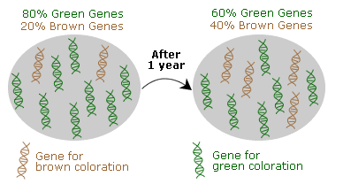
4. Genetic Mutations
- Mutations can be beneficial, neutral, or harmful
*Relative Fitness- harmful genes may incur an advantage if the environment changes

Slide 15
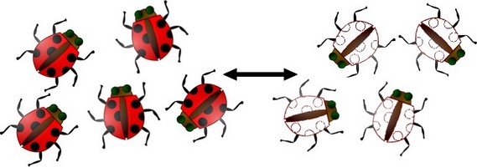
5. Gene Flow
= the movement of alleles among populations by migration (aka gene migration)
→increases variation in a population by introducing new alleles
→decreases diversity between populations,
(gene pools become more similar).
→can prevent speciation from occurring

Slide 16
So let’s focus on Natural Selection for a minute…

Slide 17
Types of Selection
Three main types of selection.
They are…

Slide 18
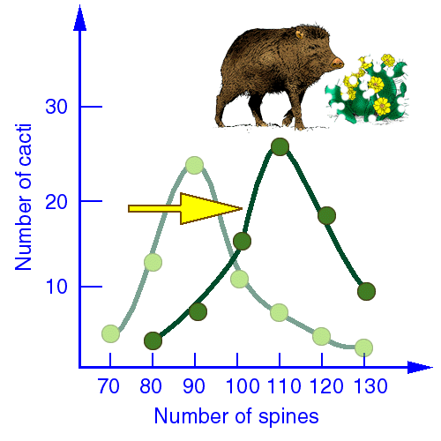
1. Directional
occurs when an extreme phenotype is favored
the allele distribution shifts towards that favored phenotype

Slide 20
2. Stabilizing
occurs when extreme phenotypes are eliminated
the intermediate phenotype is favored.
genetic diversity is decreased
opposite of disruptive selection

Slide 21
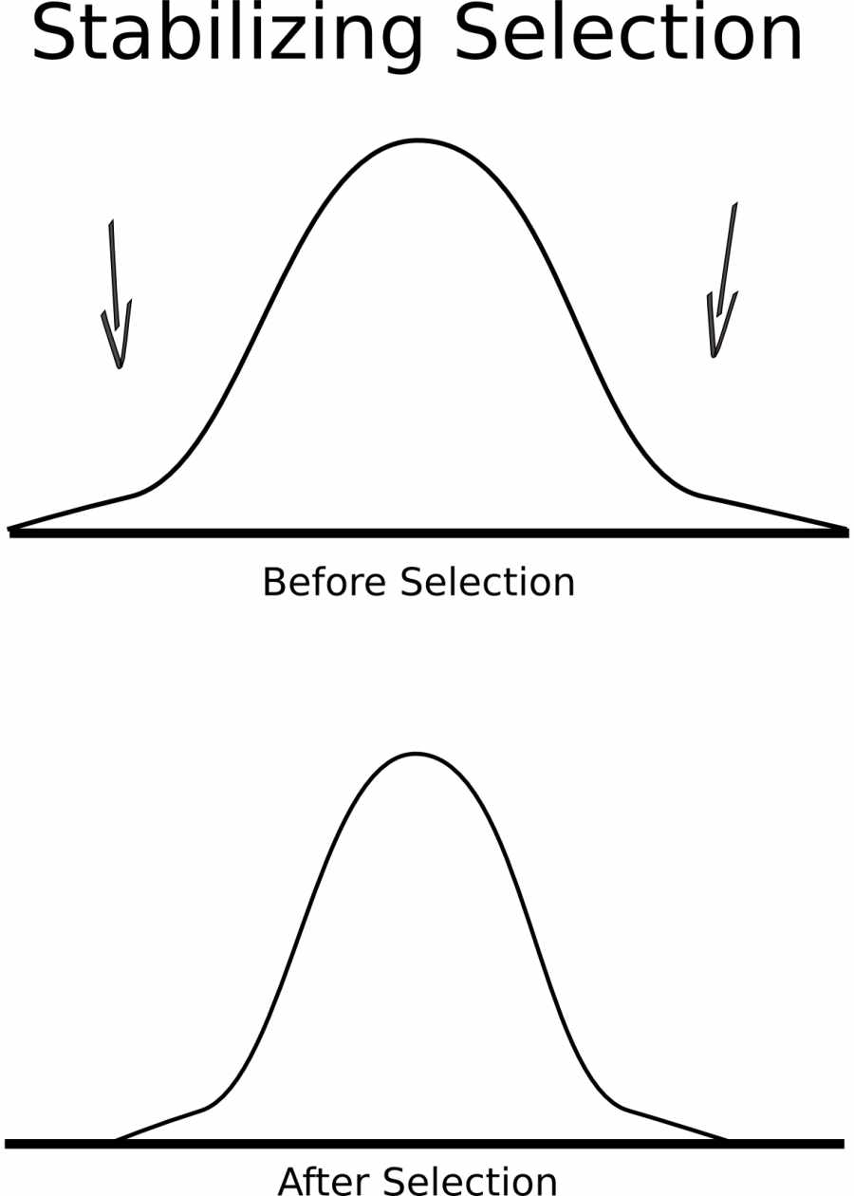

Slide 22
3. Disruptive
occurs when extreme phenotypes are favored, can lead to more than one distinct form.
also called diversifying selection
variance of the trait increases and the population is divided into two distinct groups

