Slide 1
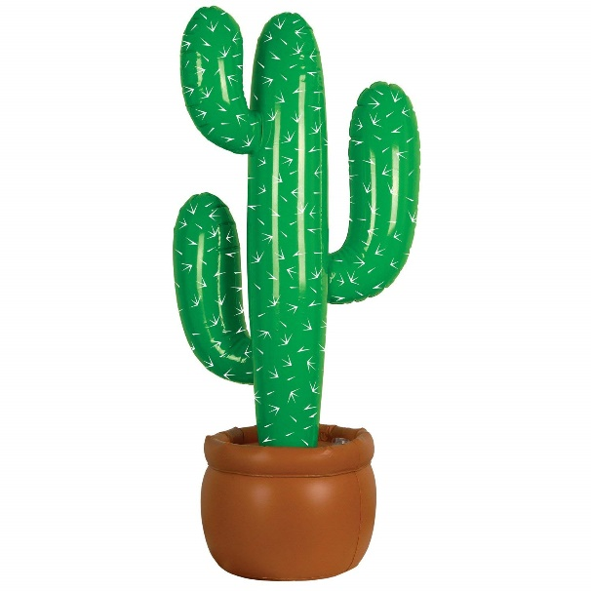
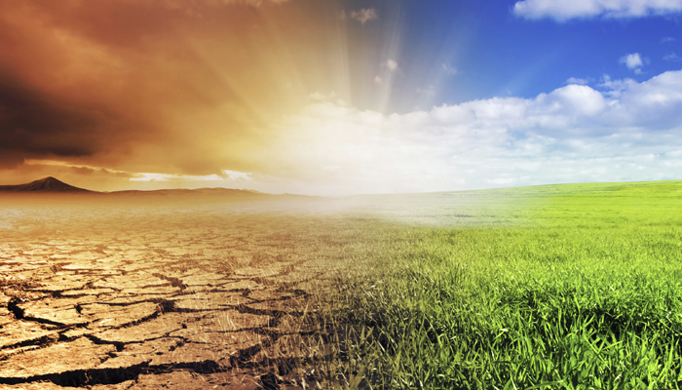
Adaptations of Plants to deal with HOT or DRY climates

Slide 2
When you’re, hot you’re hot!
Hot, arid climates → Alternative mechanisms of carbon fixation have evolved
© 2011 Pearson Education, Inc.
Notes:
2

Slide 3
In hot, dry places…
Dehydration = big problem for plants
hot, dry days → plants close stomata
  conserves H₂O but limits photosynthesis
  reduces access to CO₂ and O₂ builds up
© 2011 Pearson Education, Inc.

Slide 4
These conditions favor…
Photorespiration – a wasteful process
  consumes O₂ and organic fuel
  releases CO₂ without producing ATP or sugar
is a problem
  on a hot, dry day it can drain as much as 50% of the carbon fixed by the Calvin cycle
© 2011 Pearson Education, Inc.
Notes:
4

Slide 5
Photorespiration… what is it?
Most plants are C₃ plants
  fixation of CO₂ (via rubisco) forms a three-carbon compound (3GP)...
Buuuuut, in photorespiration, rubisco adds O₂ instead of CO₂ in the Calvin cycle, producing a two-carbon compound instead of a 3 carbon compound
  → not so good for photosynthesis and making sugars
© 2011 Pearson Education, Inc.

Slide 6
Why does this happen? Is it an evolutionary relic?
rubisco first evolved when the atmosphere had far less O₂ and more CO₂ (way way back)
Photorespiration limits damaging products of light reactions that build up in the absence of the Calvin cycle
(Now that our atmosphere is different, the advantage it provided does not really help…)
© 2011 Pearson Education, Inc.

Slide 7
C₄ Plants
Use a different enzyme –
(PEP CARBOXYLASE) to fix CO2 into 4-C compounds
  Fixed in mesophyll cells
© 2011 Pearson Education, Inc.

Slide 8
C₄ Plants cont’d
PEP carboxylase has a higher affinity for CO₂ than rubisco does
  it can fix CO₂ even when CO₂ concentrations are low
These 4C compounds → shuttled to bundle-sheath cells, → release CO₂ that is then used in the Calvin cycle
© 2011 Pearson Education, Inc.
Notes:
8

Slide 9
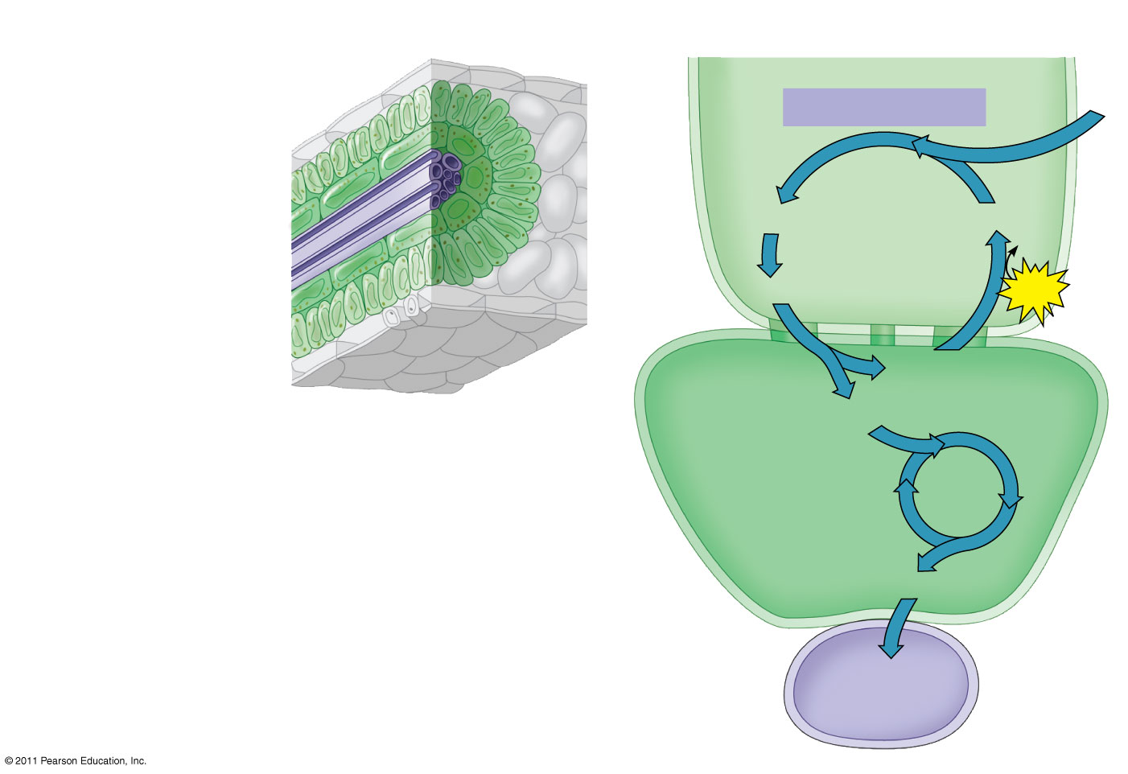
Figure 10.20
C₄ leaf anatomy
The C₄ pathway
Mesophyll
cell
Mesophyll cell
PEP carboxylase
CO₂
Photosynthetic
cells of C₄
plant leaf
Bundle-
sheath
cell
Oxaloacetate (4C)
PEP (3C)
Vein
(vascular tissue)
ADP
Malate (4C)
ATP
Bundle-
sheath
cell
Pyruvate (3C)
Stoma
CO₂
Calvin
Cycle
Sugar
Vascular
tissue
Notes:
9
Figure 10.20 C₄ leaf anatomy and the C₄ pathway.

Slide 10
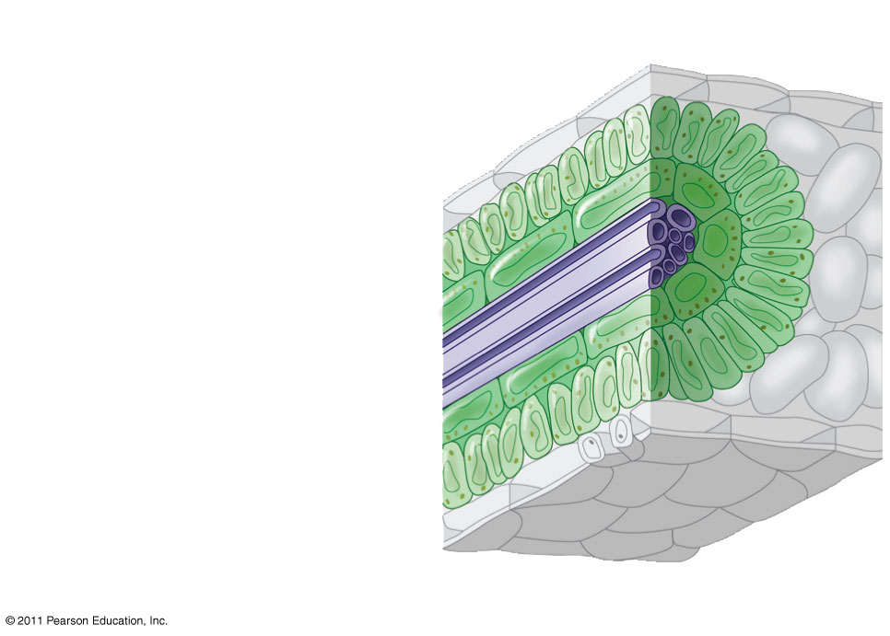
Figure 10.20a
C₄ leaf anatomy
Mesophyll cell
Photosynthetic
cells of C₄
plant leaf
Bundle-
sheath
cell
Vein
(vascular tissue)
Stoma
Notes:
10
Figure 10.20 C₄ leaf anatomy and the C₄ pathway.

Slide 11
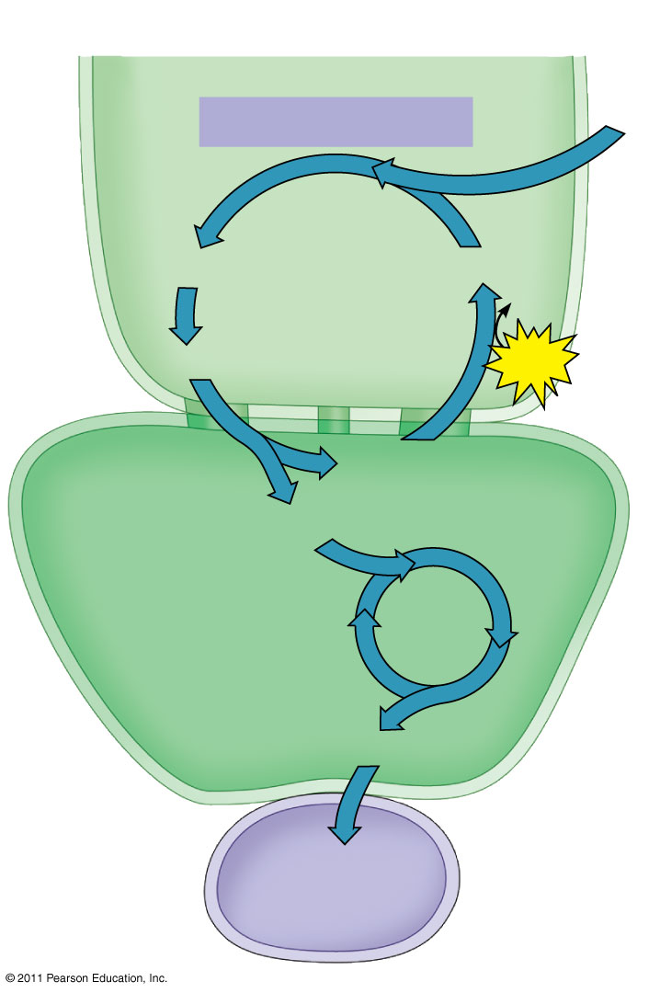
Figure 10.20b
The C₄ pathway
Mesophyll
cell
CO₂
PEP carboxylase
Oxaloacetate (4C)
PEP (3C)
ADP
Malate (4C)
ATP
Pyruvate (3C)
Bundle-
sheath
cell
CO₂
Calvin
Cycle
Sugar
Vascular
tissue
Notes:
11
Figure 10.20 C₄ leaf anatomy and the C₄ pathway.

Slide 12
dem darn CO2 levels
Increasing levels of CO₂ may affect C₃ and C₄ plants differently,
  May be changing the relative abundance of these species
The effects of such changes are unpredictable and a cause for concern
© 2011 Pearson Education, Inc.

Slide 13
CAM Plants (another mechanism)
Some plants, including succulents, use crassulacean acid metabolism (CAM) to fix carbon
CAM plants open their stomata at night
  incorporating CO₂ into organic acids
Stomata close during the day, and CO₂ is released from organic acids and used in the Calvin cycle
© 2011 Pearson Education, Inc.

Slide 14
So one mechanism changes the place where the Calvin Cycle takes place, and one changes the time when it takes place.

Slide 15
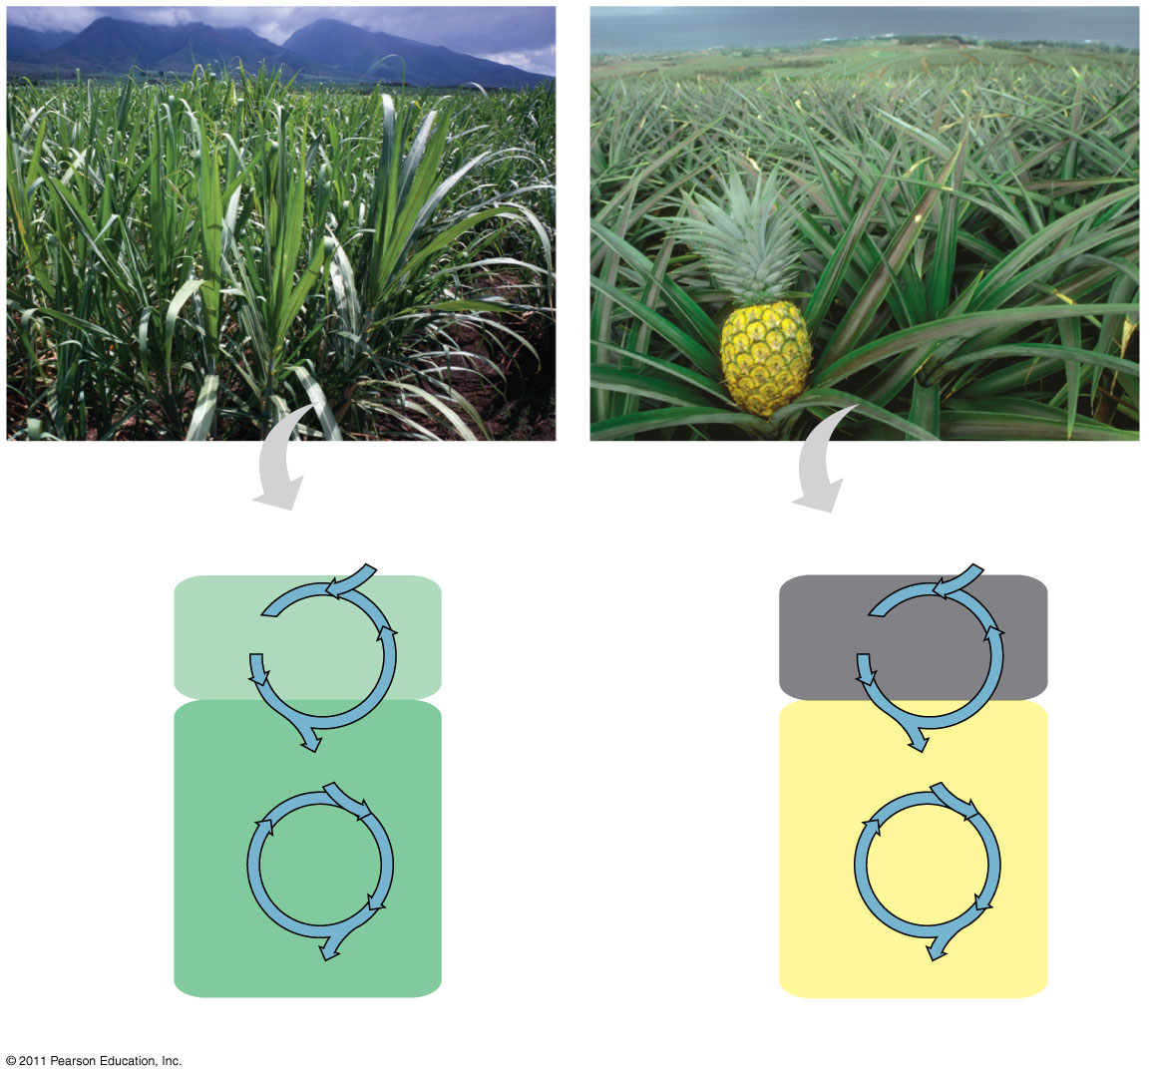
Figure 10.21
Sugarcane
Pineapple
C₄
CO₂
CAM
CO₂
1
CO₂ incorporated
(carbon fixation)
Mesophyll
cell
Organic acid
Organic acid
Night
CO₂
CO₂
Bundle-
sheath
cell
2
CO₂ released
to the Calvin
cycle
Day
Calvin
Cycle
Calvin
Cycle
Sugar
Sugar
(a) Spatial separation of steps
(b) Temporal separation of steps
Notes:
15
Figure 10.21 C₄ and CAM photosynthesis compared.

Slide 16
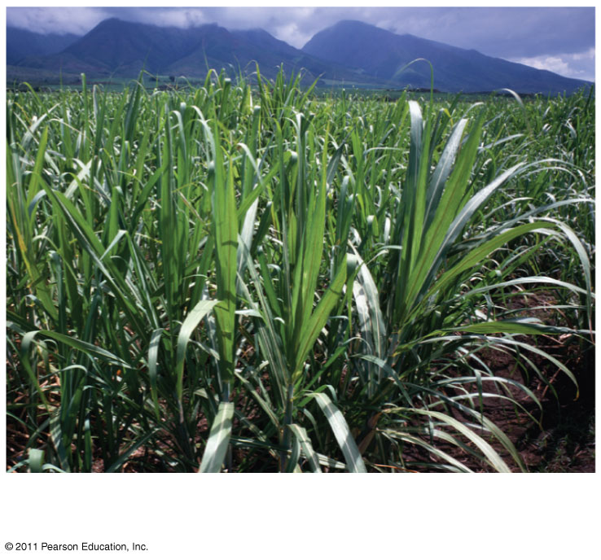
Figure 10.21a
C4/CAM Video
Sugarcane
Notes:
16
Figure 10.21 C₄ and CAM photosynthesis compared.

Slide 17
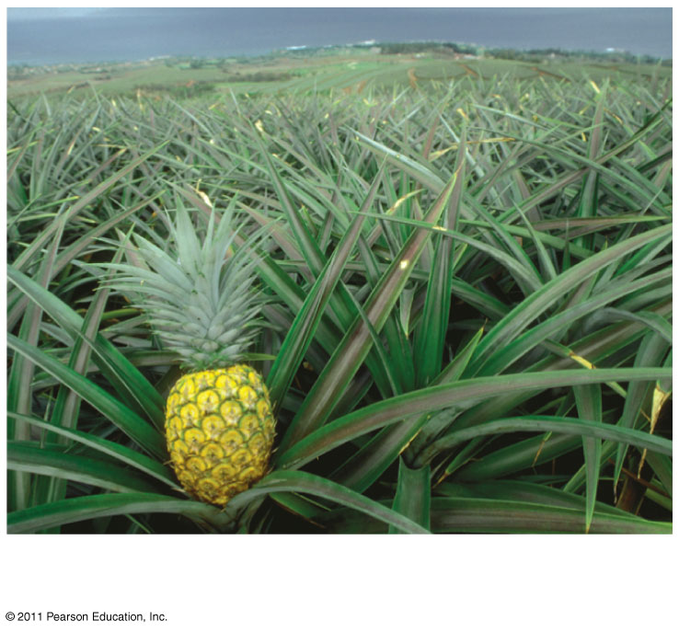
Figure 10.21b
Pineapple
Notes:
17
Figure 10.21 C₄ and CAM photosynthesis compared.

